Slide 1
Portofolio Campaign Analytics

Slide 2
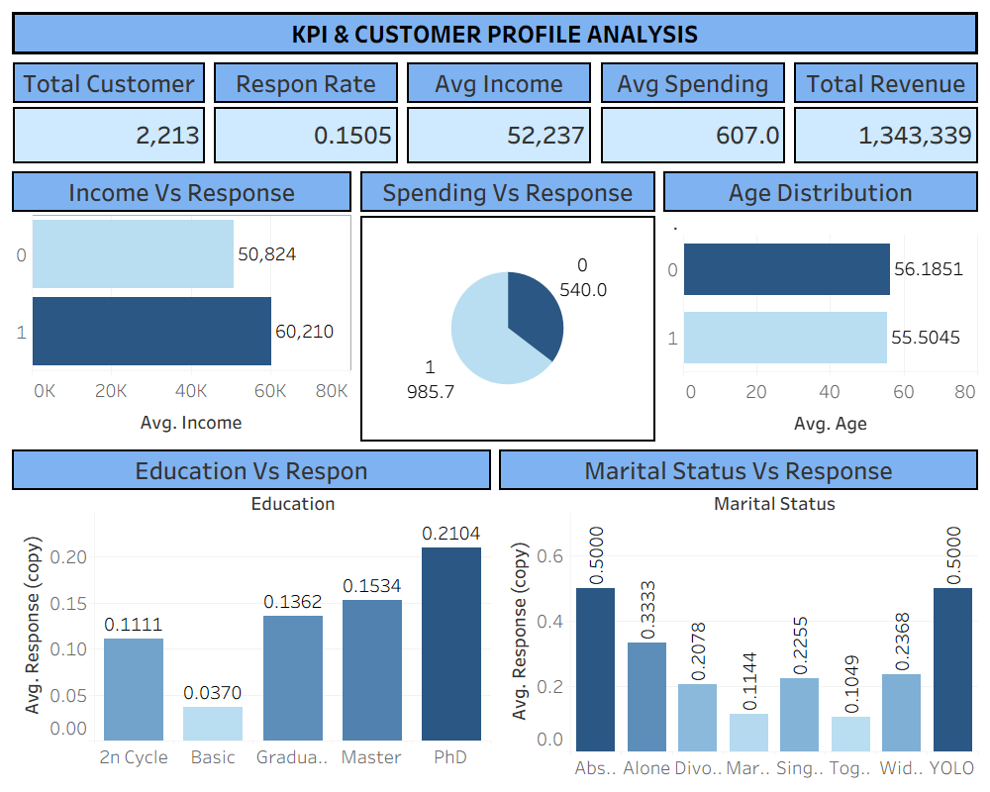

Slide 3
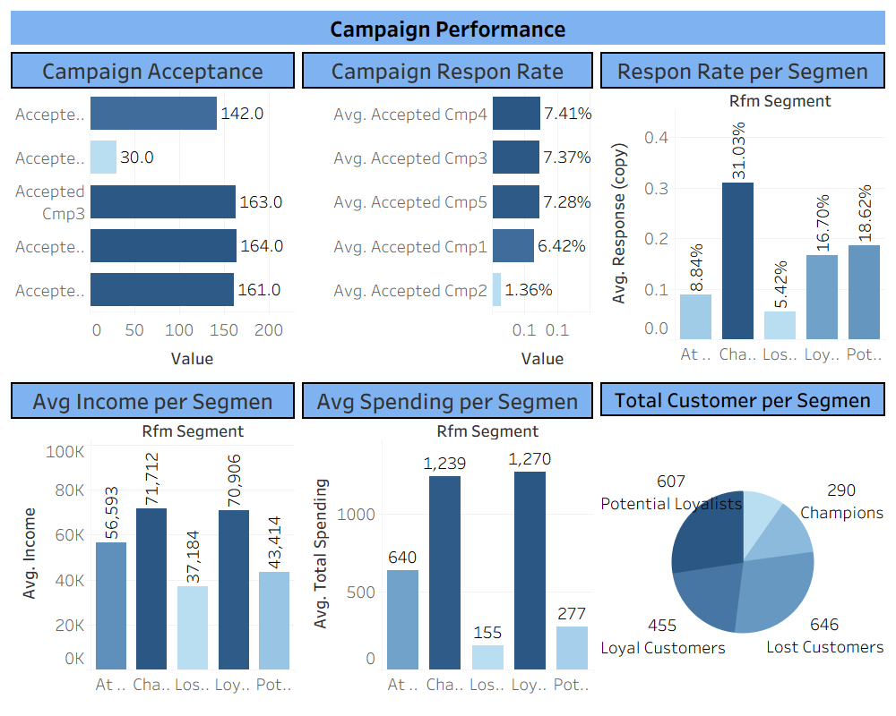

Slide 4
